Slide 1


Python For The Parseltongues
Day 1
with
Sabbir Mollah
and
Mostafa Didar

Slide 2
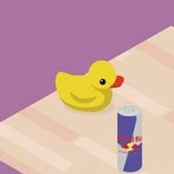
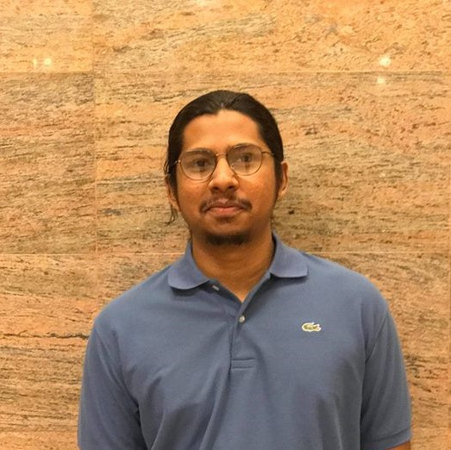
About the Instructors
Sabbir Mollah
Mostafa Didar
Is a rubber duck
Loves Chess and Star Wars
Previously worked as a Game Developer
Python enthusiast
Is a long haired Potato
Loves Writing , Music, Sports, anything that gets the creativity flowing
Actively involved in Data Science

Slide 3
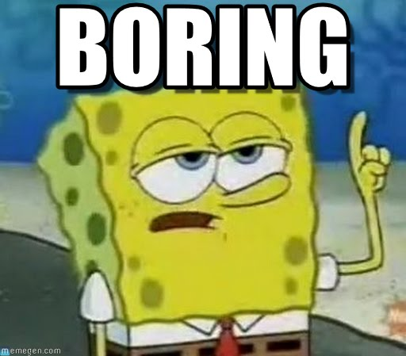
Overview

Slide 4
What is Python?
A popular open source programming language
Free, portable, powerful
Interpreted
Object Oriented
Strongly typed + Dynamically typed
Focused on readability and productivity

Slide 5
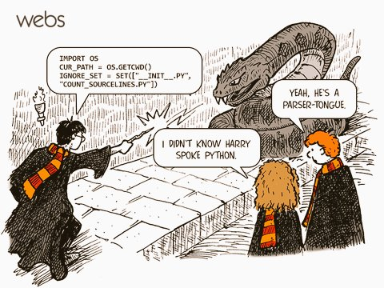
Why is it called Python?
The name derived from a comedy show titled “Monty Python” and not from a snake.
More about the name: https://docs.python.org/2/faq/general.html#why-is-it-called-python
Image: https://www.improgrammer.net/wp-content/uploads/2017/12/IMG_-lzibnn.jpg

Slide 6
A brief history of Python
Benevolent dictator for life (BDFL)
GUIDO VAN ROSSUM started working in 1989
Python 3.X broke backward compatibility

Slide 7
Why use Python?
Downsides?
Batteries Included
Readability, portability, maintainability
Less to type
Pleasure
THERE IS ONLY ONE OBVIOUS WAY
Execution Speed
Dependency problem

Slide 8
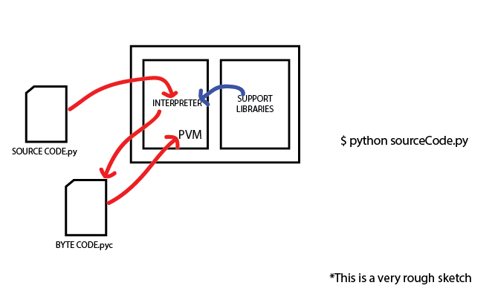
Under the hood
Interpreted language
CPython, Jytthon,
IronPython, Pypy...

Slide 9
Who uses Python?
Google search engine
Youtube video sharing
Dropbox file sharing
Nasa for scientific researches
IBM for hardware testing
NSA for cryptography
Rasberry Pi promotes it
Intel, Hp, Qualcomm, ETC...

Slide 10
Let’s get our hands dirty
Give people a tool and they’ll code for a day; teach them how to build tools, and they’ll code for a lifetime.

Slide 11
How to run your Python code?
Let me show you!

Slide 12
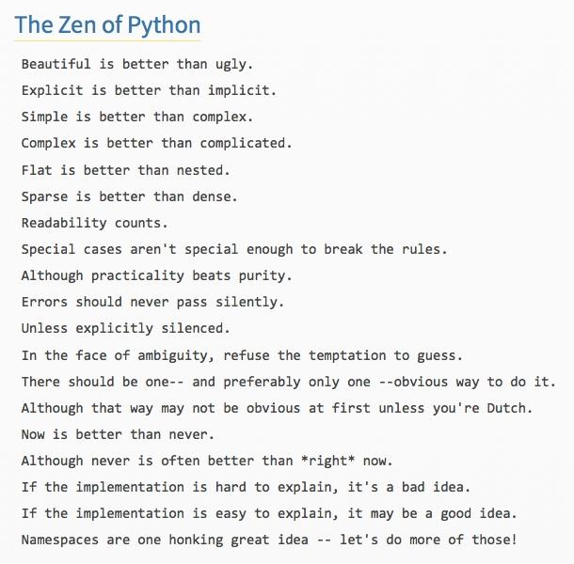
The Zen Of Python
>>> import this

Slide 13
Python is engineering, not ART
Programs are made of modules
Modules consist of Statements
Statements contain expressions
Expressions process and create objects

Slide 14
Core Data Types
Numbers
Strings
Lists
Dictionaries
Tuples
Sets, Booleans, Files...

Slide 15
Conditions and Loops
If...else
a = 200
b = 33
if b > a:
print("b is greater than a")
elif a == b:
print("a and b are equal")
else:
print("a is greater than b")
LOOPS:
while i < 6:
print(i)
i += 1
fruits = ["apple", "banana", "cherry"]
for x in fruits:
print(x)

Slide 16
Try yourself
ODD OR EVEN
Prime Number
Count digits in a string

Slide 17
Functions
def sayName(name = "John Cena"):
print("My name is " + name)
sayName("Clark Kent")
sayName("Tony Stark")
sayName()
sayName("Voldemort")

Slide 18
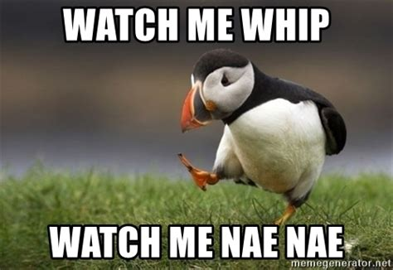
Watch me code

Slide 19
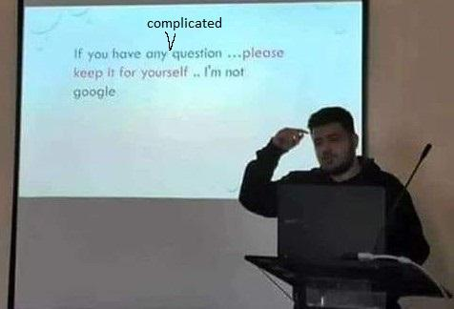
Questions?

Slide 20
Thank you

